Slide 1
BOOK MANAGEMENT SYSTEM IN C++
BY: HARSHIT PATEL
ESSENTIAL OF SOFTWARE FOUNDATION & PROGRAMMING-II

Slide 2
CONCEPTS USED IN PROGRAM
HEADER FILE - iostream, string, fstream , cstring .
CLASS & OBJECT
FILE HANDLING
VOID
USER-DEFINED FUNCTIONS
<conio.h>
<string.h>
<iomanip>
int main()
getline()
getchar()

Slide 3
HEADER FILES
iostream: iostream stands for standard input-output stream. This header file contains definitions of objects like cin, cout,etc.
string.h : This header file contains macro definitions, constants and declarations of functions and types used not only for string handling but also various memory handling function
fstream : This is used to both read and write data from file.
cstring : The cstring header file contains definitions for C++ for manipulating several kinds of strings . cstring tracks the length of character data so that it can more securely watch the data and the space it requires .

Slide 4
CONCEPTS USED IN PROGRAM
Class & Object : A class is defined in C++ using keyword class followed by the name of class. The body of class is defined inside the curly brackets and terminated by a semicolon at the end. Declaring Objects: When a class is defined, only the specification for the object is defined; no memory or storage is allocated.
File Handling : File handling in C++ is a mechanism to store the output of a program in a file and help perform various operations on it. Files help store these data permanently on a storage device.
Loops :
if 🡺if statement is the most simple decision-making statement. It is used to decide whether a certain statement or block of statements will be executed or not
while 🡺 A while loop evaluates the condition. If the condition evaluates to true , the code inside the while loop is executed. The condition is evaluated again. This process continues until the condition is false .

Slide 5
BUILT-IN FUNCTIONS
int main() : 'int main' means that our function needs to return some integer at the end of the execution and we do so by returning 0 at the end of the program. 0 is the standard for the “successful execution of the program” .
getline () : ‘getline’ is an in-built function defined in the <string. h> header file that allows accepting and reading single and multiple line strings from the input stream.
getchar() : ’ getchar’ function is equivalent to a call to getc(stdin). It reads the next character from stdin which is usually the keyboard .

Slide 6
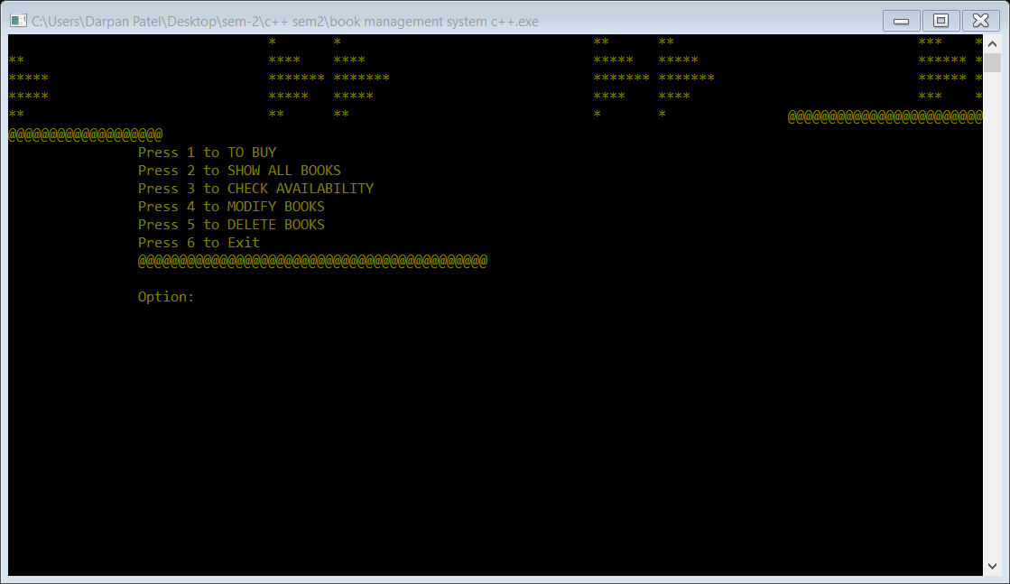
OUTPUT SCREEN
This is how screen will look like

Slide 7
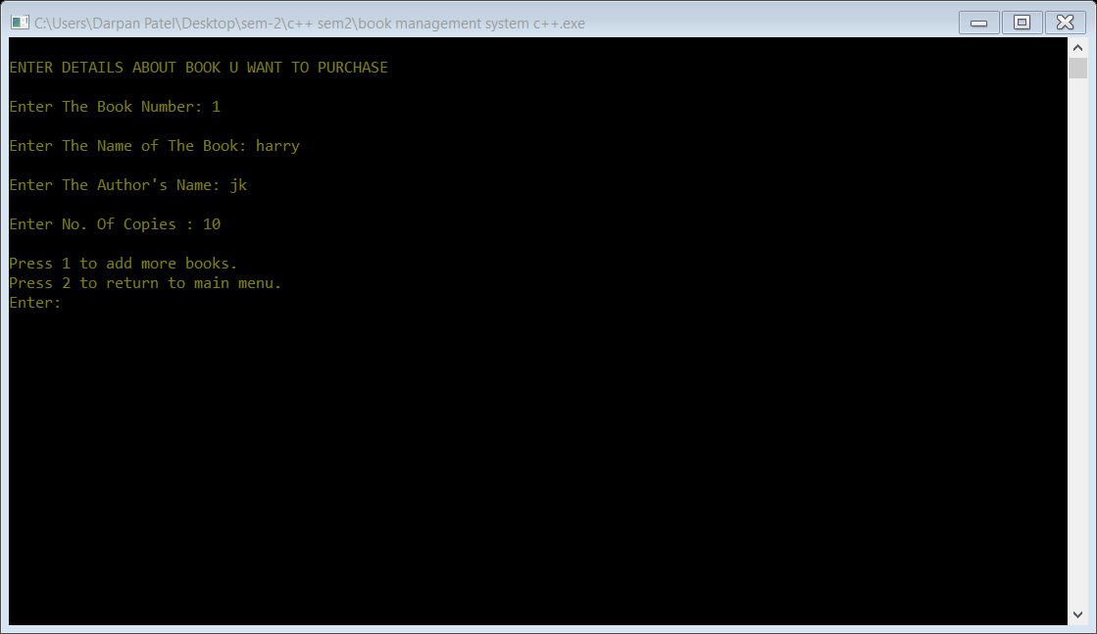
ENTERING DETAILS
TO BUY

Slide 8
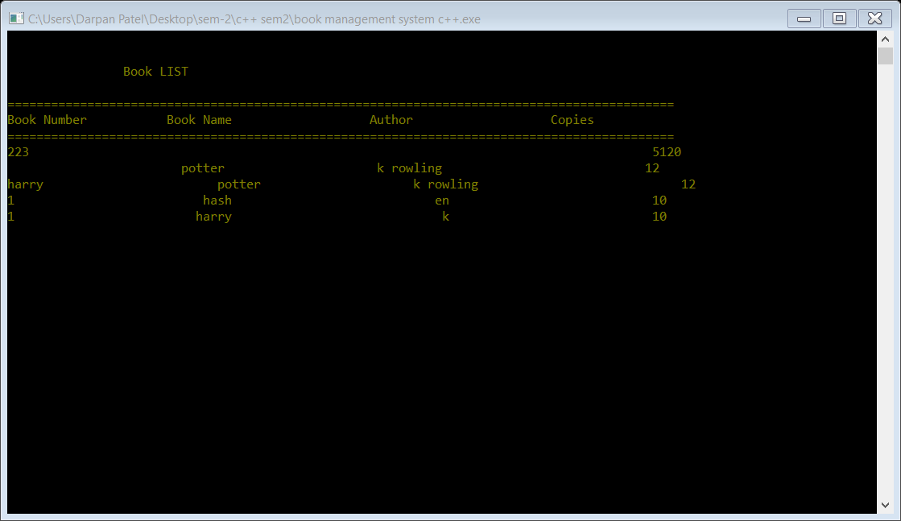
IT SHOWS AVAILABLE BOOKS
ON OUTPUT SCREEN

Slide 9
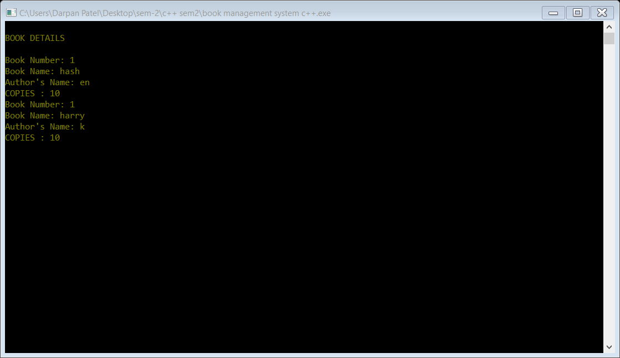
IT CHECK’S BOOK
AVAILABLITY

Slide 10
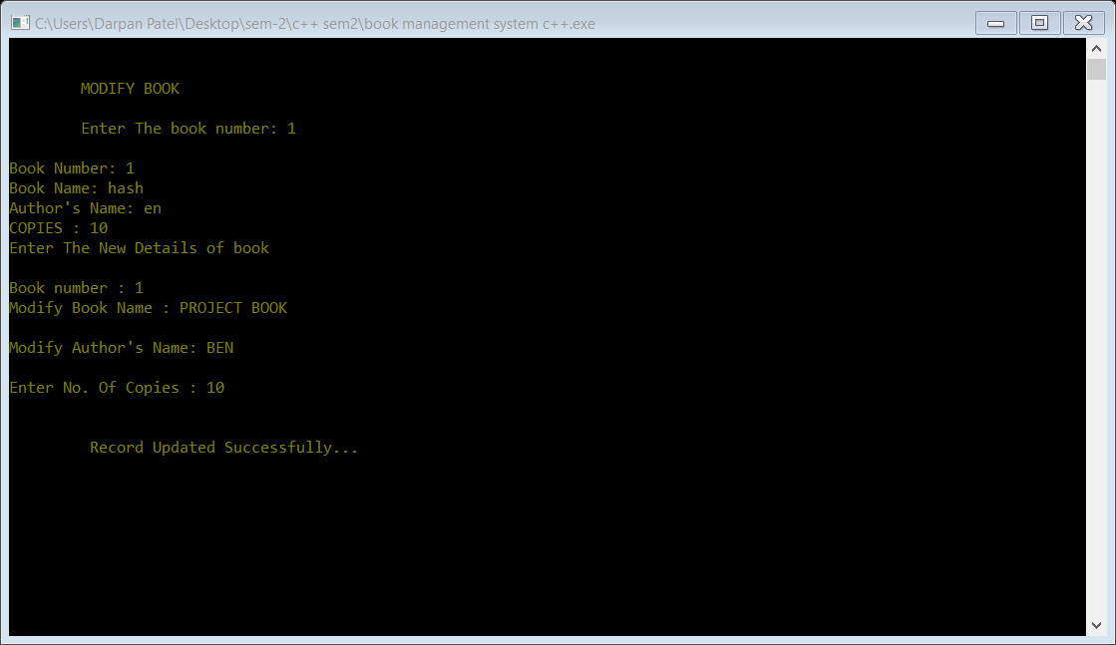
TO MODIFY BOOKS NAME
& AUTHER NAME

Slide 11
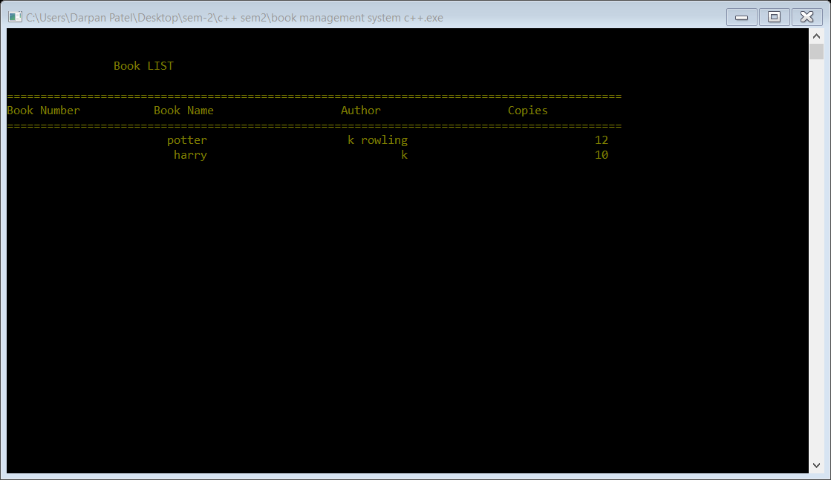
DATA DELETED
OF BOOKS

Slide 12
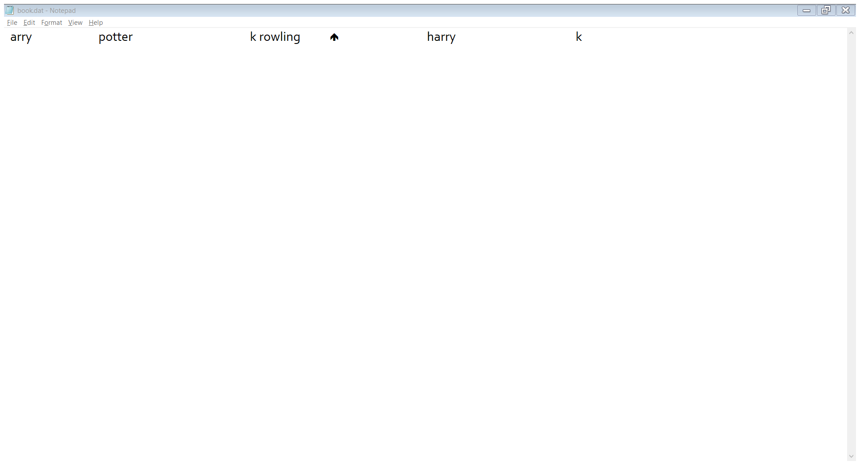
FILE

Slide 13
THANK YOU FOR WATCHING MY PROJECT

